Slide 1
MyPass
CIS 476 Term Project
Group: Shahd Mustafa and Zeinab Alrubaiee

Slide 2
Project description
MyPass Software Application Overview:
Stores and secures users' sensitive information, including license numbers, passport numbers, and credit card details.
Allows users to create an account with a username, email, password, and three security questions.
Provides the option for users to create their own password or use the password generator for enhanced security.
Password recovery

Slide 3
Class Diagrams

Slide 4
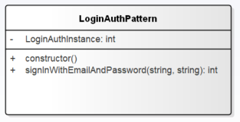
Singleton Pattern
Manages user login session
Constructor: checks for pre-existing instance, or creates a new one.
signInWithEmailAndPassword: takes username and password.
If authentication is success -> user logged in

Slide 5
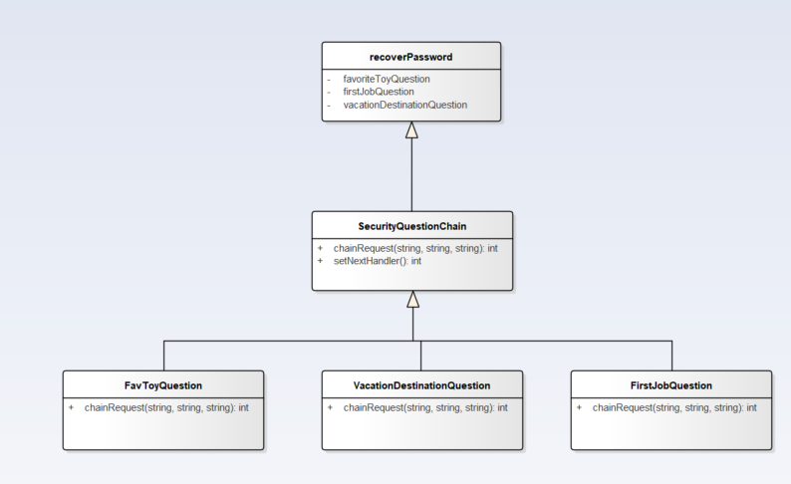
Chain of Responsibility Pattern
Creates a secure process for users to recover forgotten password.
Handles 3 security questions
Displays master password

Slide 6
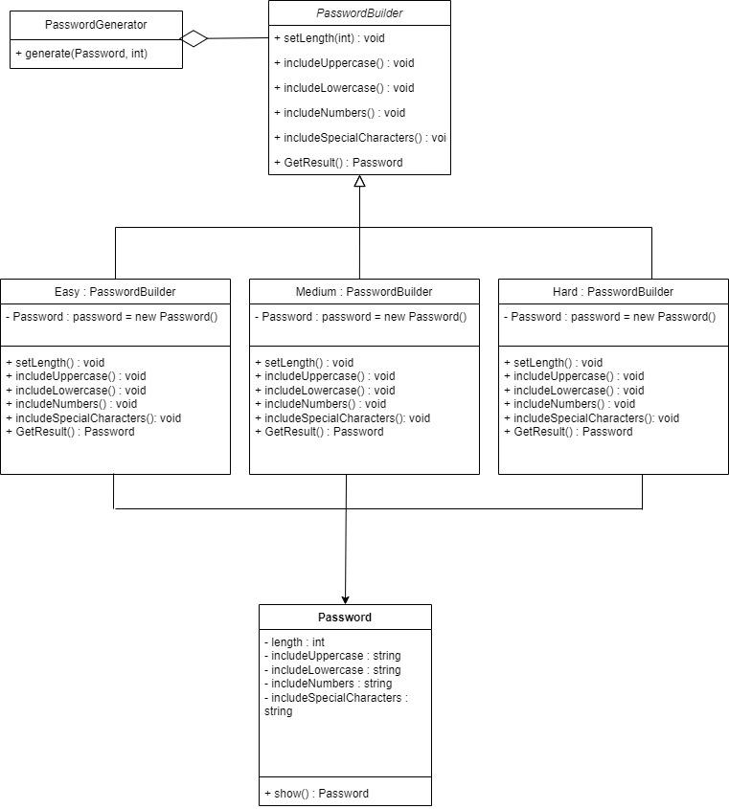
Builder Pattern
Allows the user to specify the length and difficulty of a generated password.
Difficulty is divided into Easy, Medium, and Hard.
Easy difficulty includes only uppercase and lowercase letters
Medium difficulty includes uppercase letters, lowercase letters, and numbers.
Hard difficulty includes all the above along with special characters.
Provides an efficient way to handle user specified password with varying difficulty and length.

Slide 7
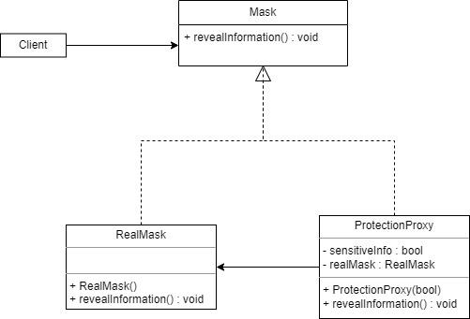
Proxy Pattern
Masks and unmasks sensitive information.
Protects unmasked information by using a Proxy class, called ProtectionProxy in this particular instance.
In other words, provides an added layer of security for any information that may compromise the user’s identity and documentation.

Slide 8
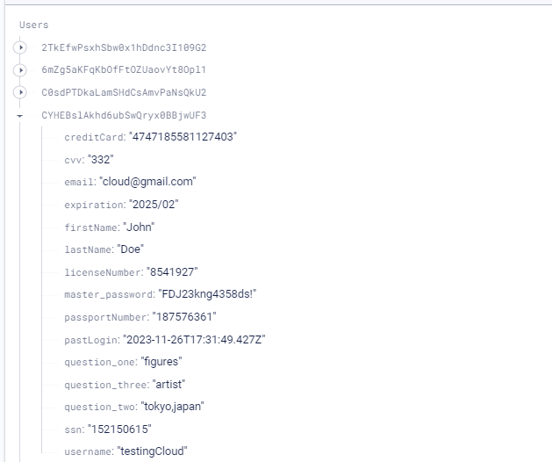
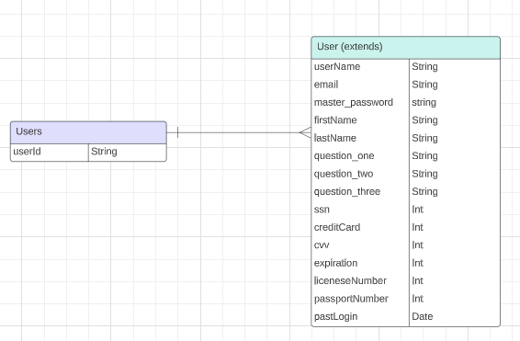
Database Schema

Slide 9
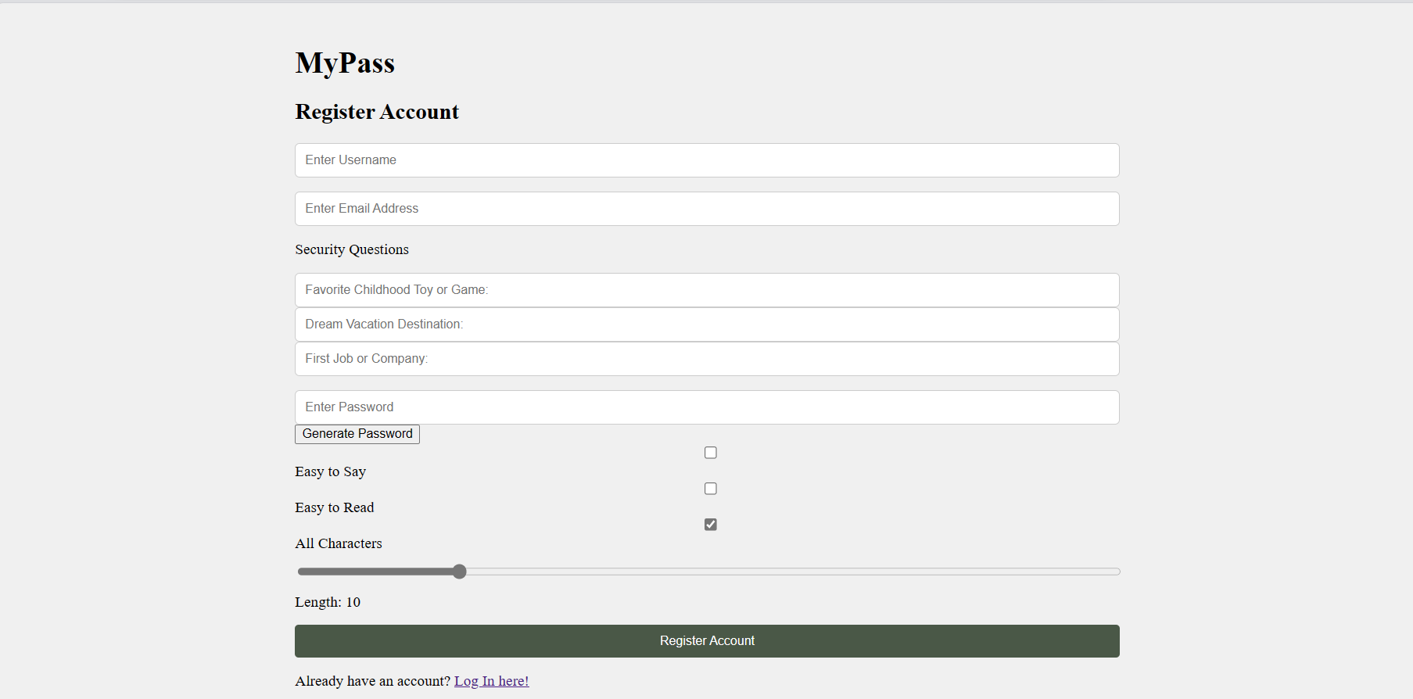
User interface
https://shahdmu34.github.io/TermProject-476/

Slide 10
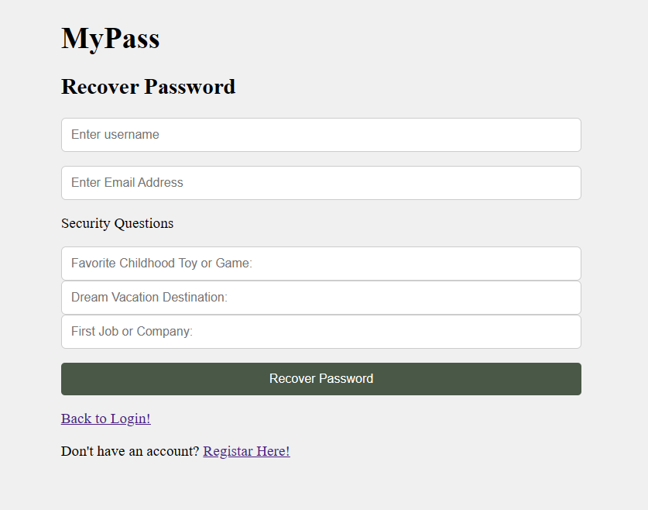
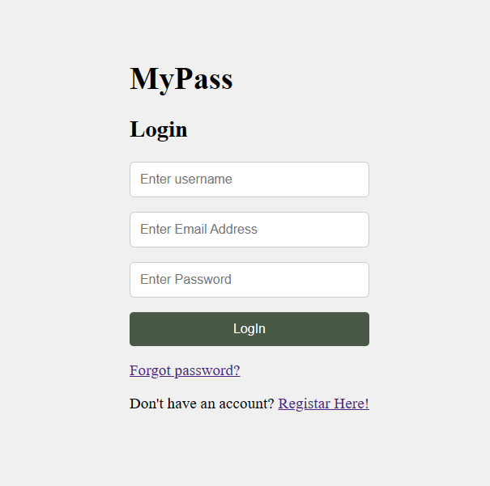

Slide 11
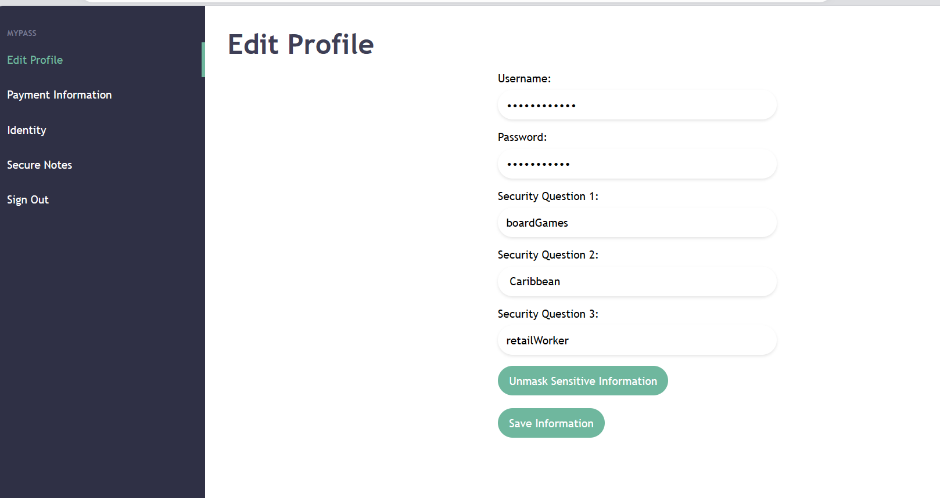

Slide 12
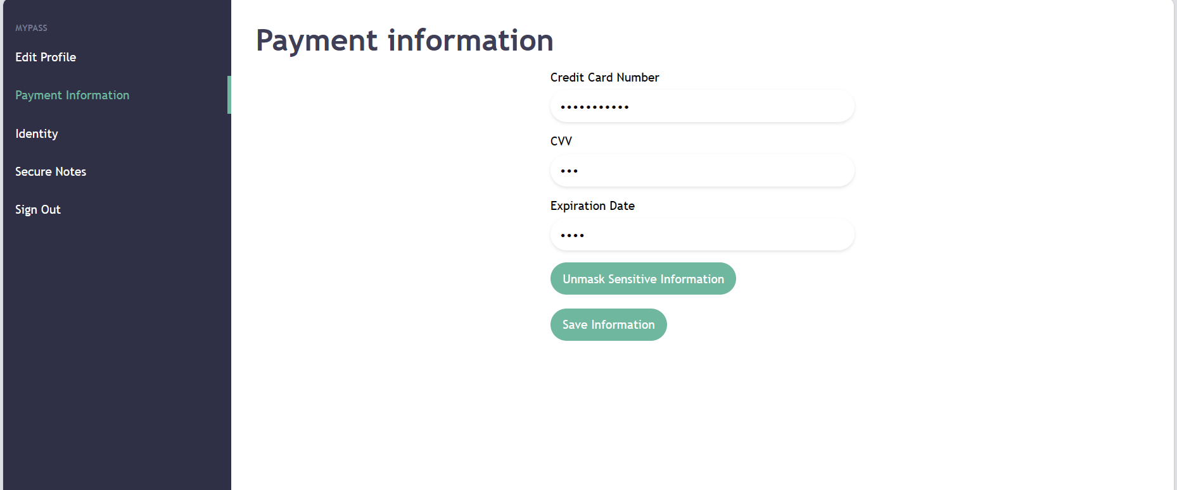

Slide 13
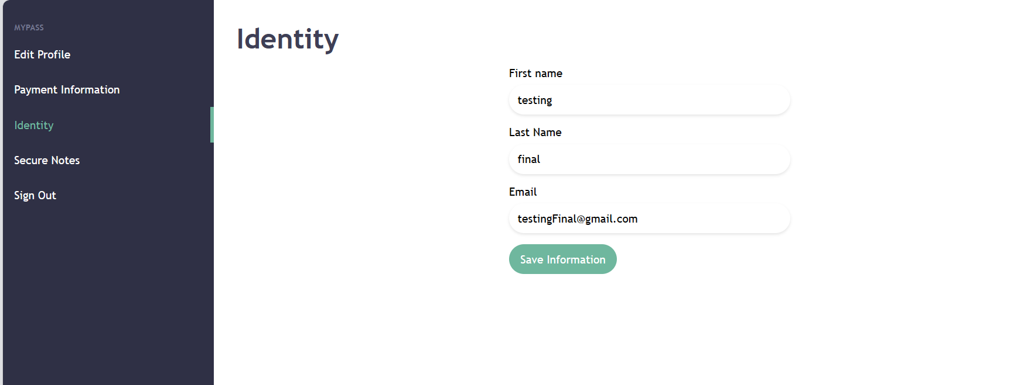

Slide 14
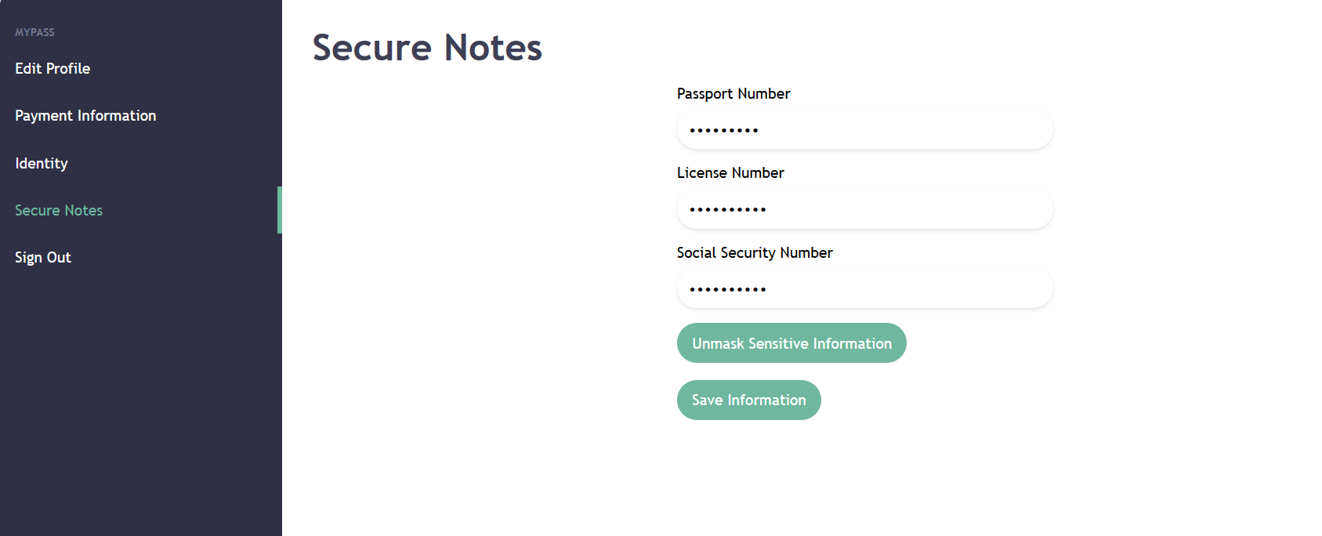

Slide 15
References
“Manage Users in Firebase.” Firebase, https://firebase.google.com/docs/auth/web/manage-users.

